Slide 1
Analysis of Phase Jump Occurrence in IGS Station Data
Zijun Liu

Slide 2
Motivation and Objective
Global Positioning System (GPS) is an important technology that many of us use everyday
A major source of error impacting GPS measurements are cycle slips / phase jumps
We use the dual-frequency TEC combination as an easy way to identify cycle slips in data
We explore occurrence of cycle slips: do they occur for certain satellites, certain locations around the Earth, when satellites are in particular part of the sky
Understanding the answers to these questions helps us design and use GPS station data more effectively
Notes:
Make into bullets
GNSS is important technology that we use everyday
There are sometime large jumps in measurements due to signal blockage or ionosphhere activity
In this project, want to identify some factors associated with these jumps

Slide 3
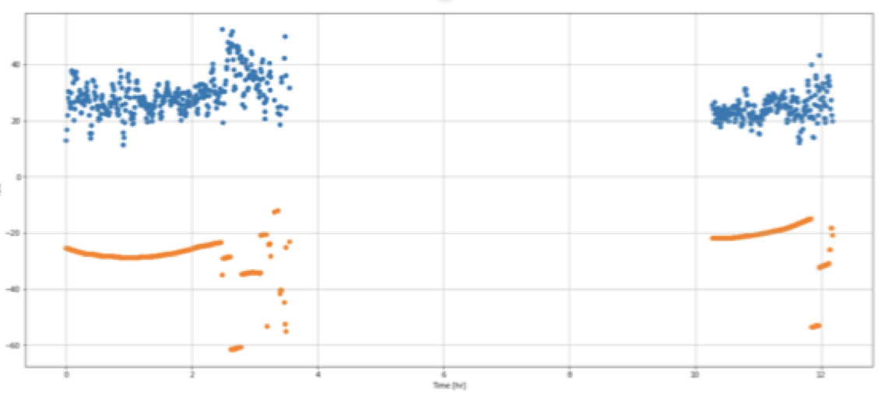
TEC
TEC line is Total Electron Content.
Notes:
Explain TEC – what is the acronym
Total electron content

Slide 4
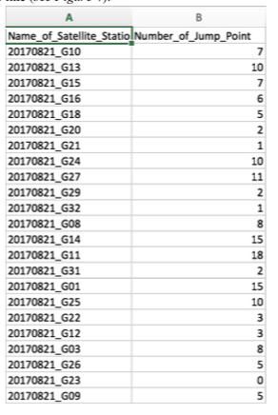
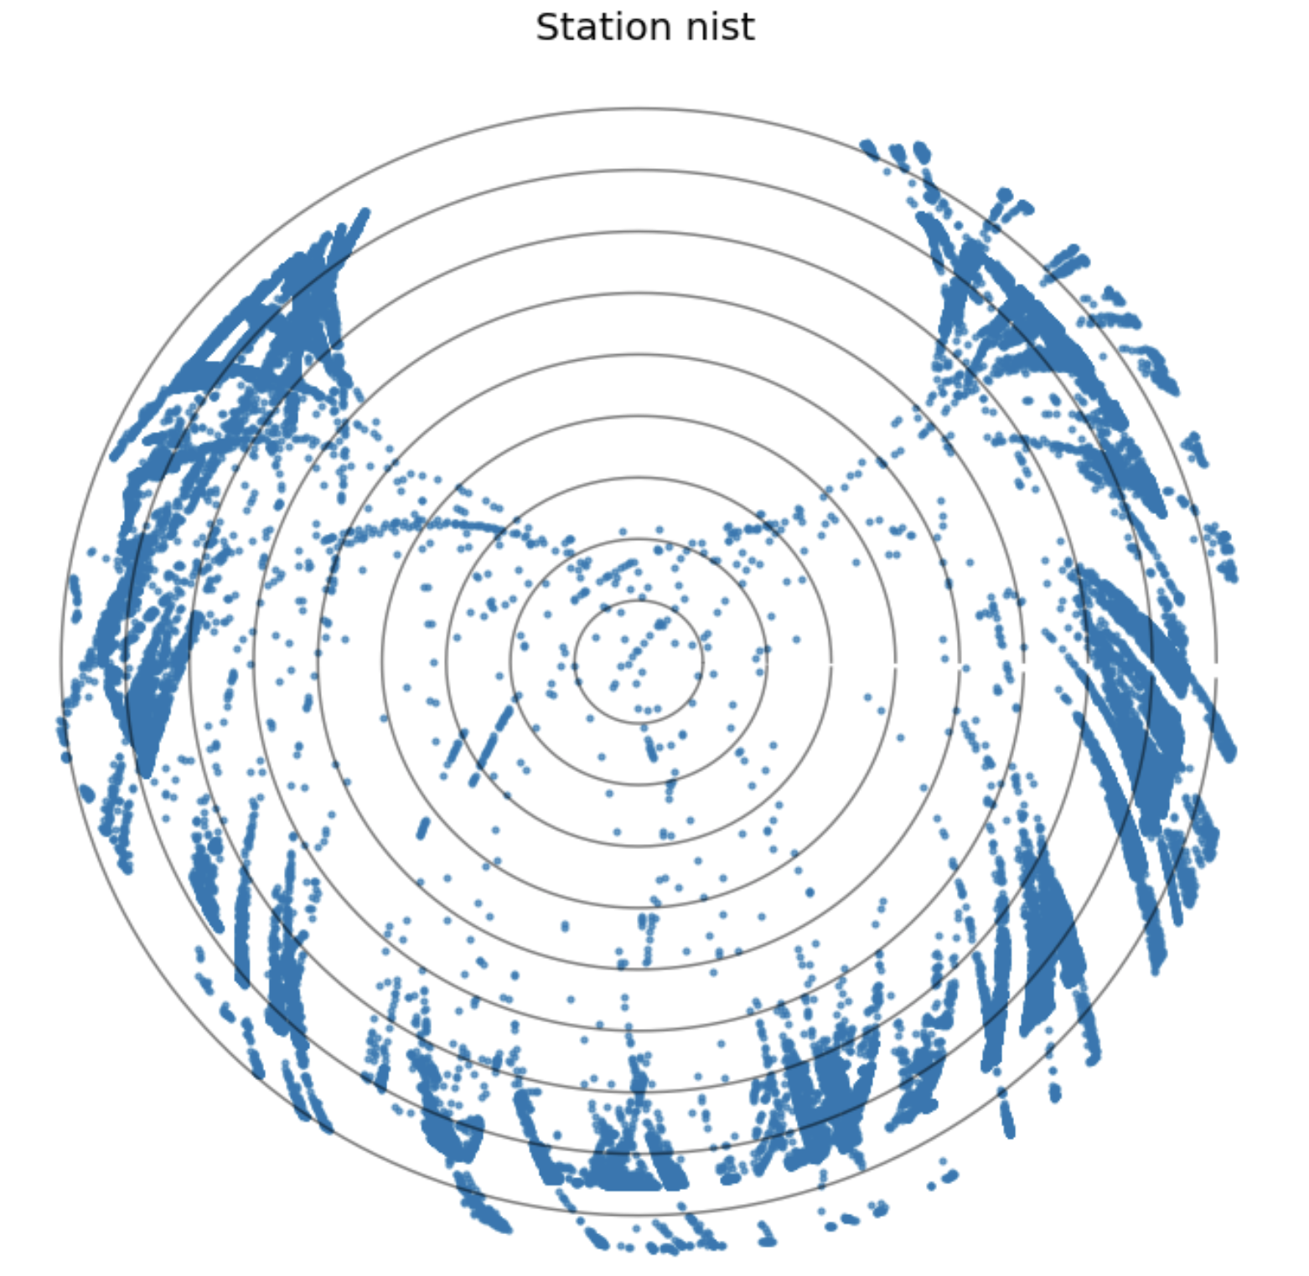
Methodology
Download and process all data for a given station for 2017
Make TEC plots
Detect TEC jumps and enter into table
Make analysis plots to identify factors associated with phase jumps

Slide 5
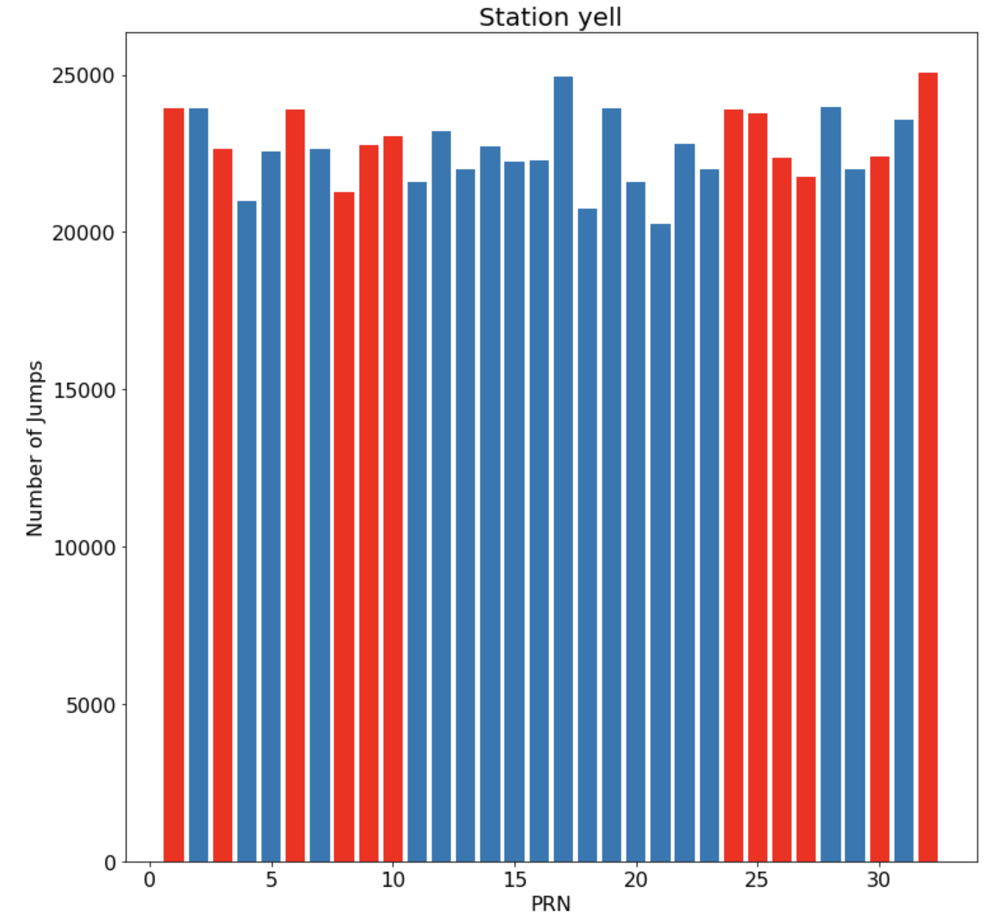
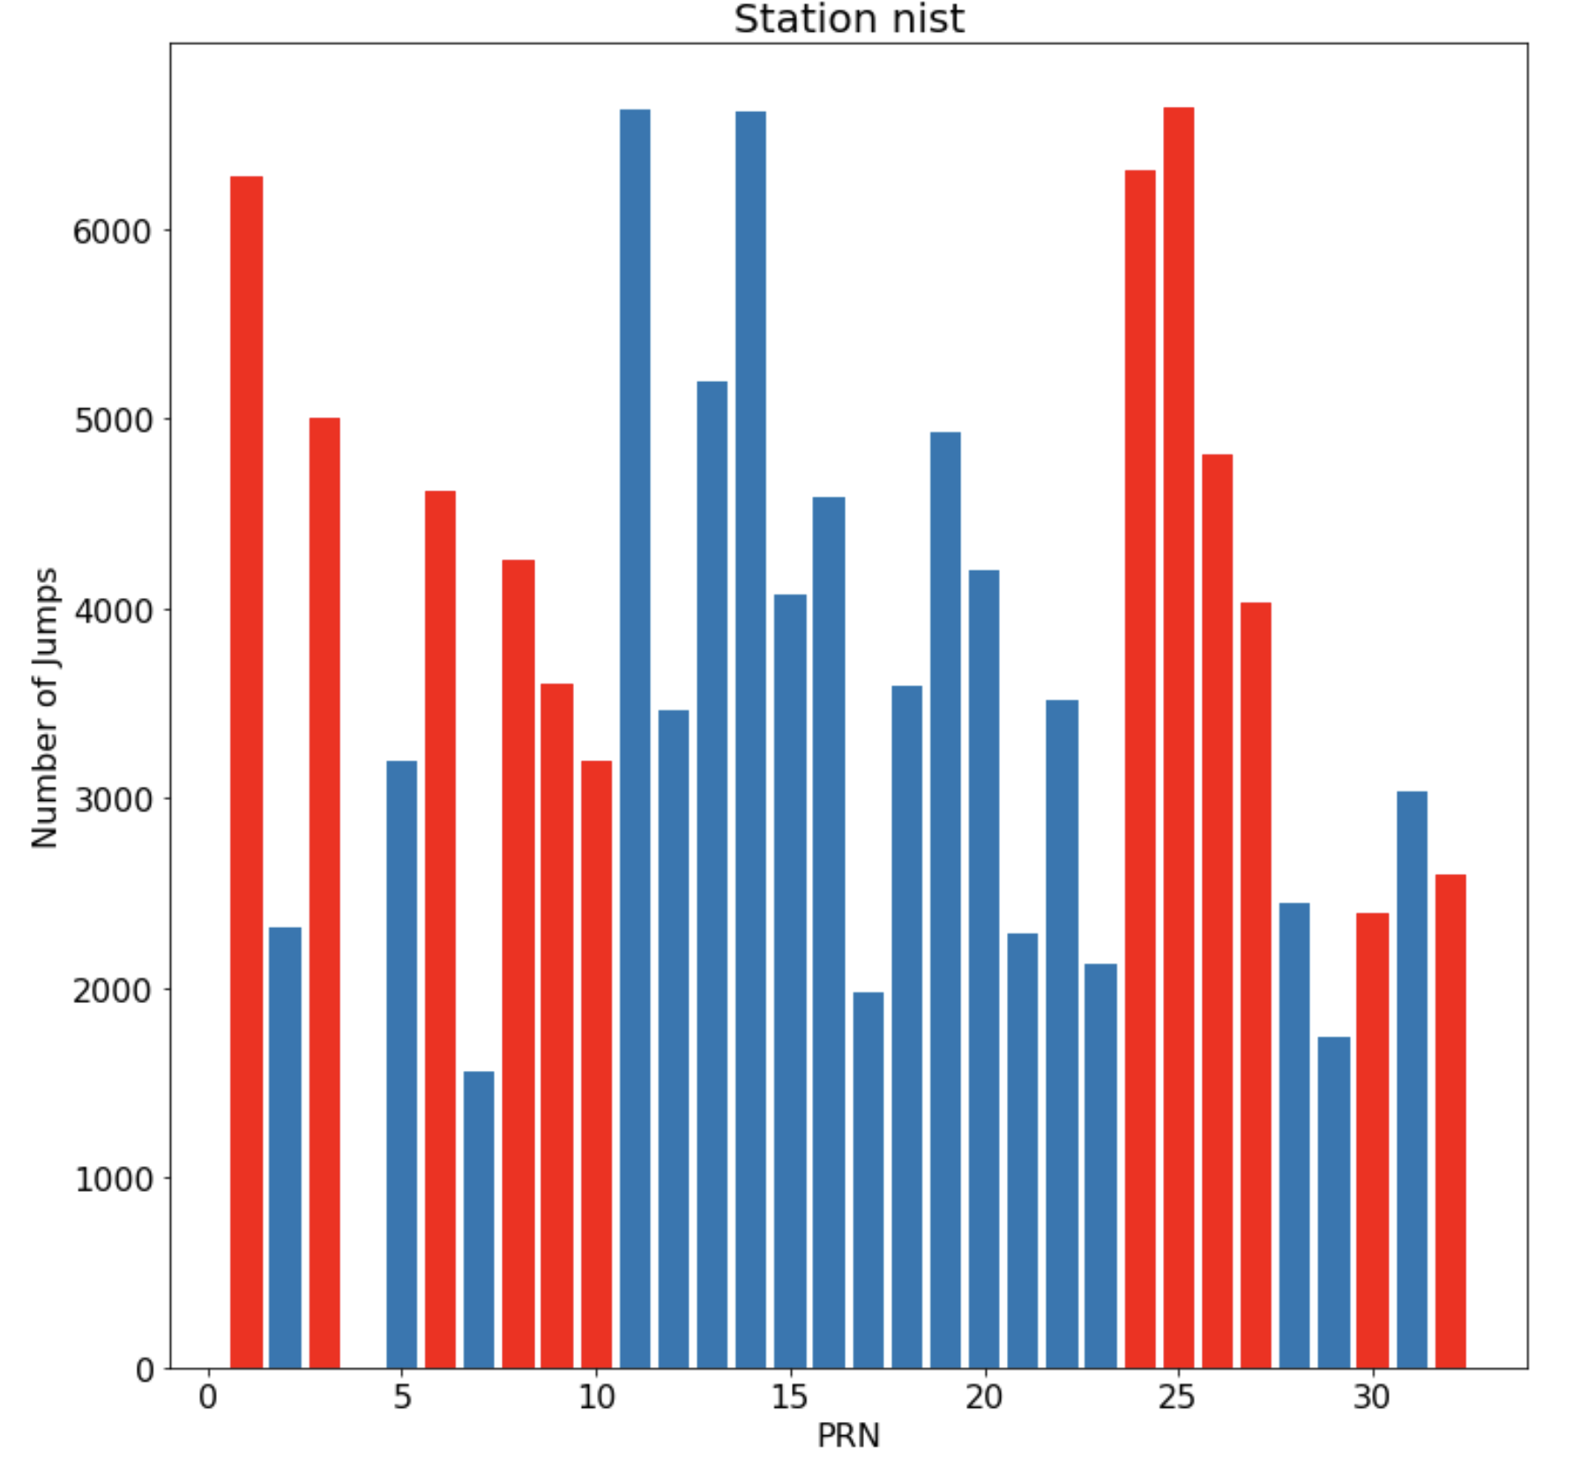
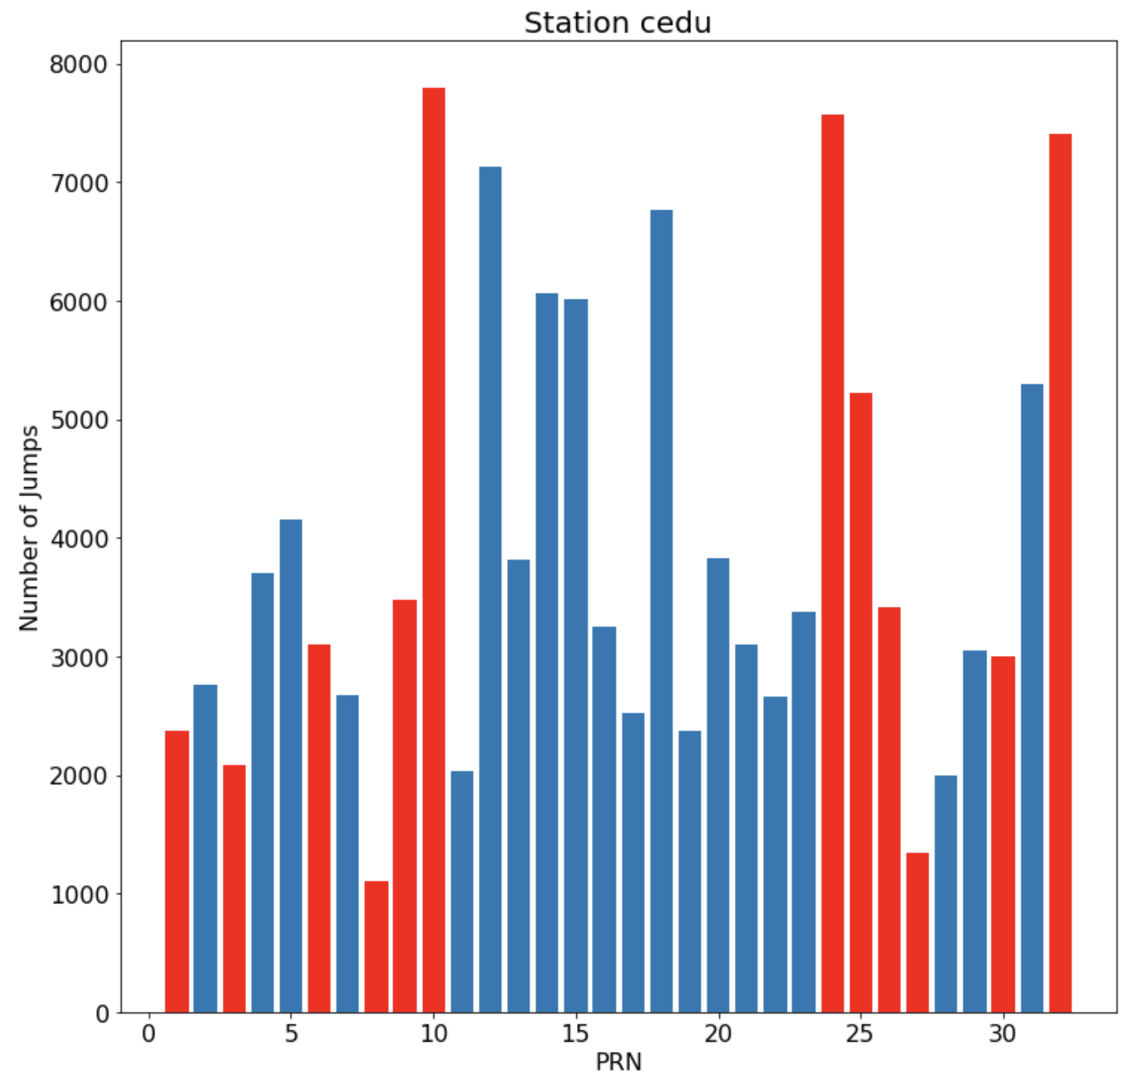
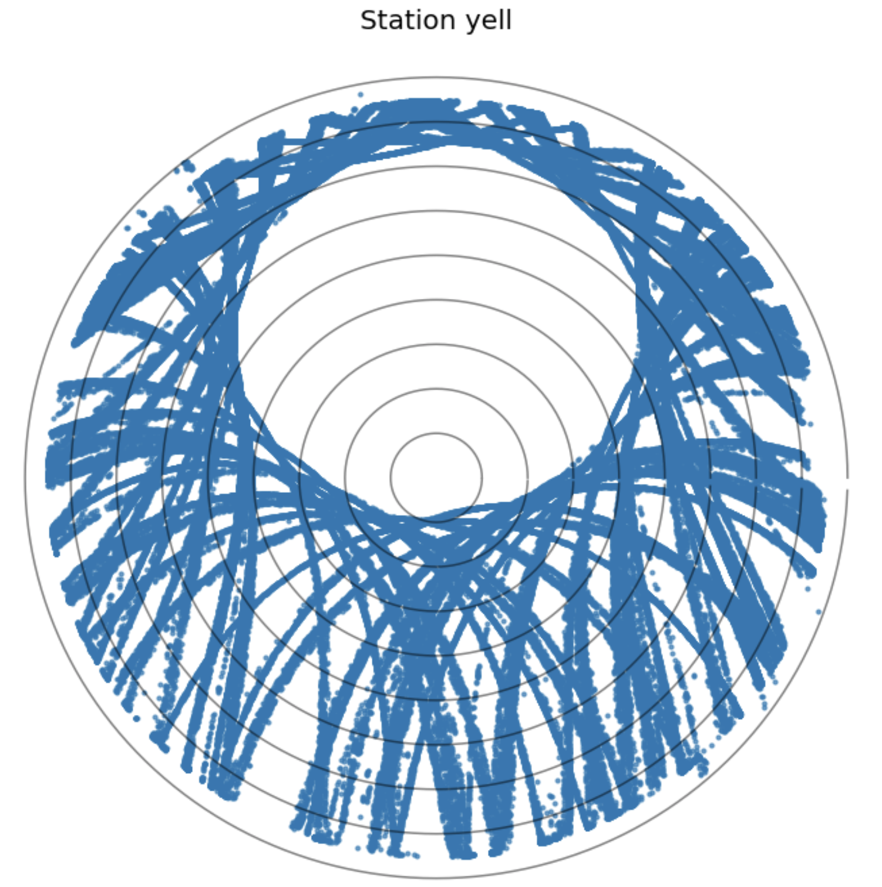
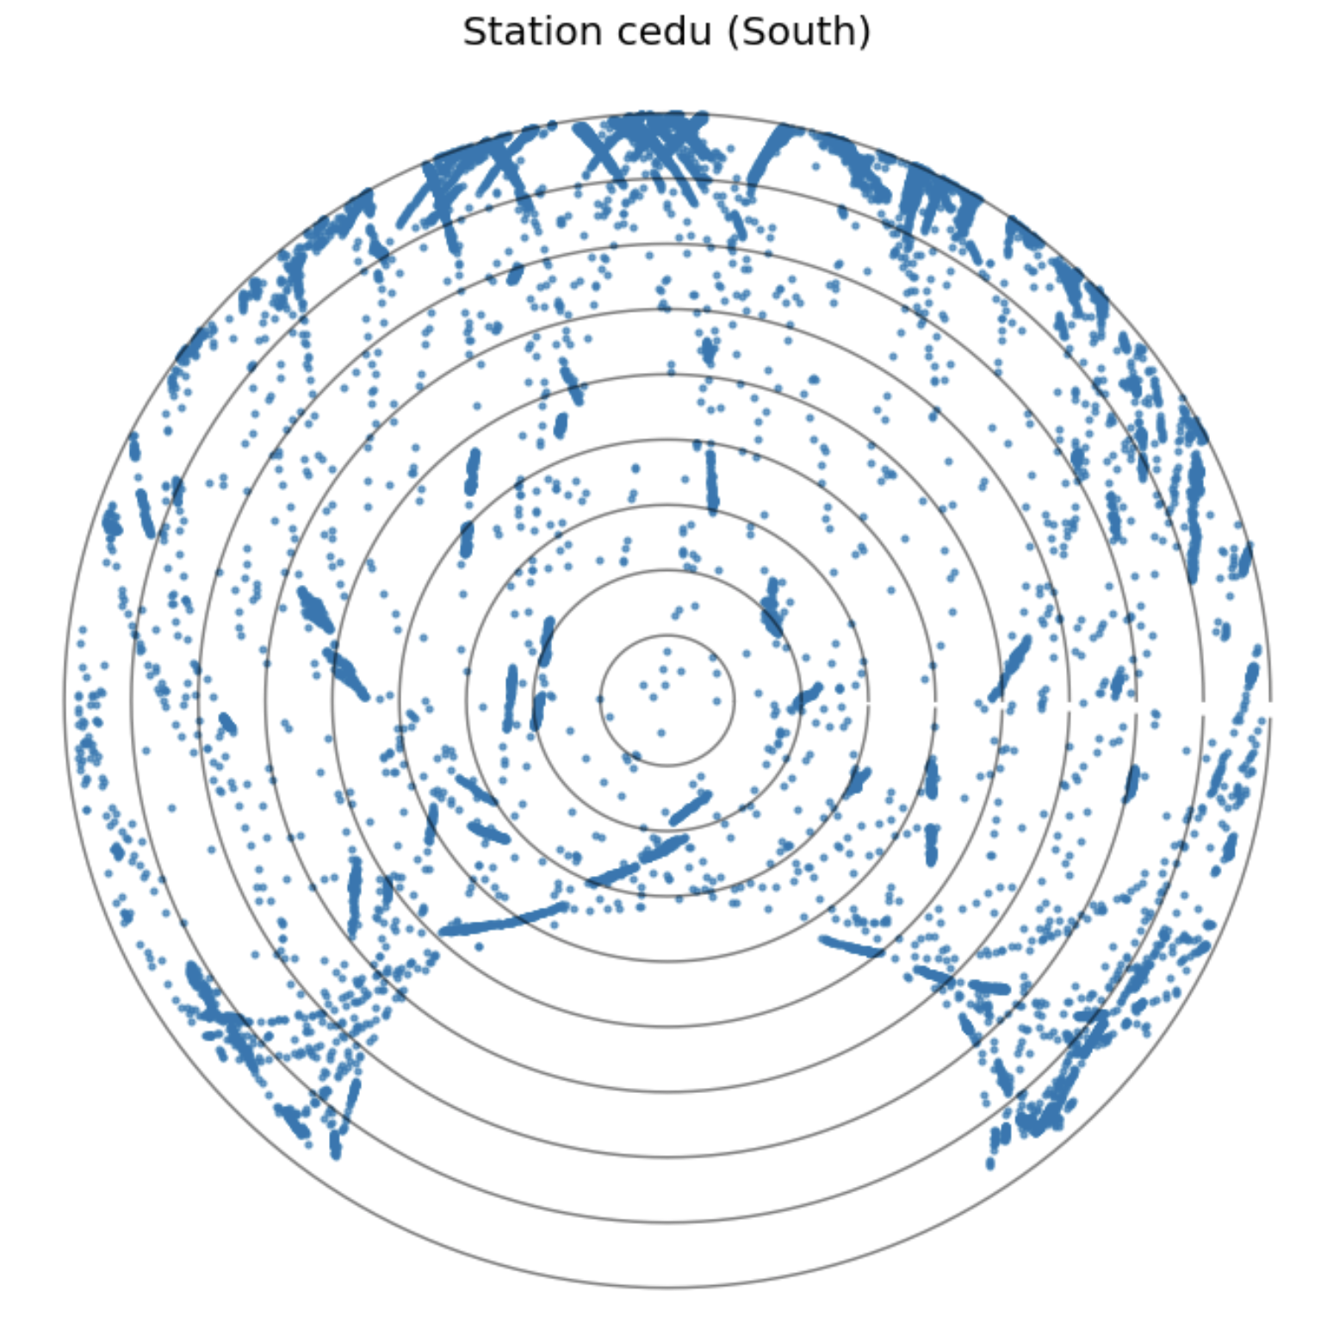
Result

Slide 6
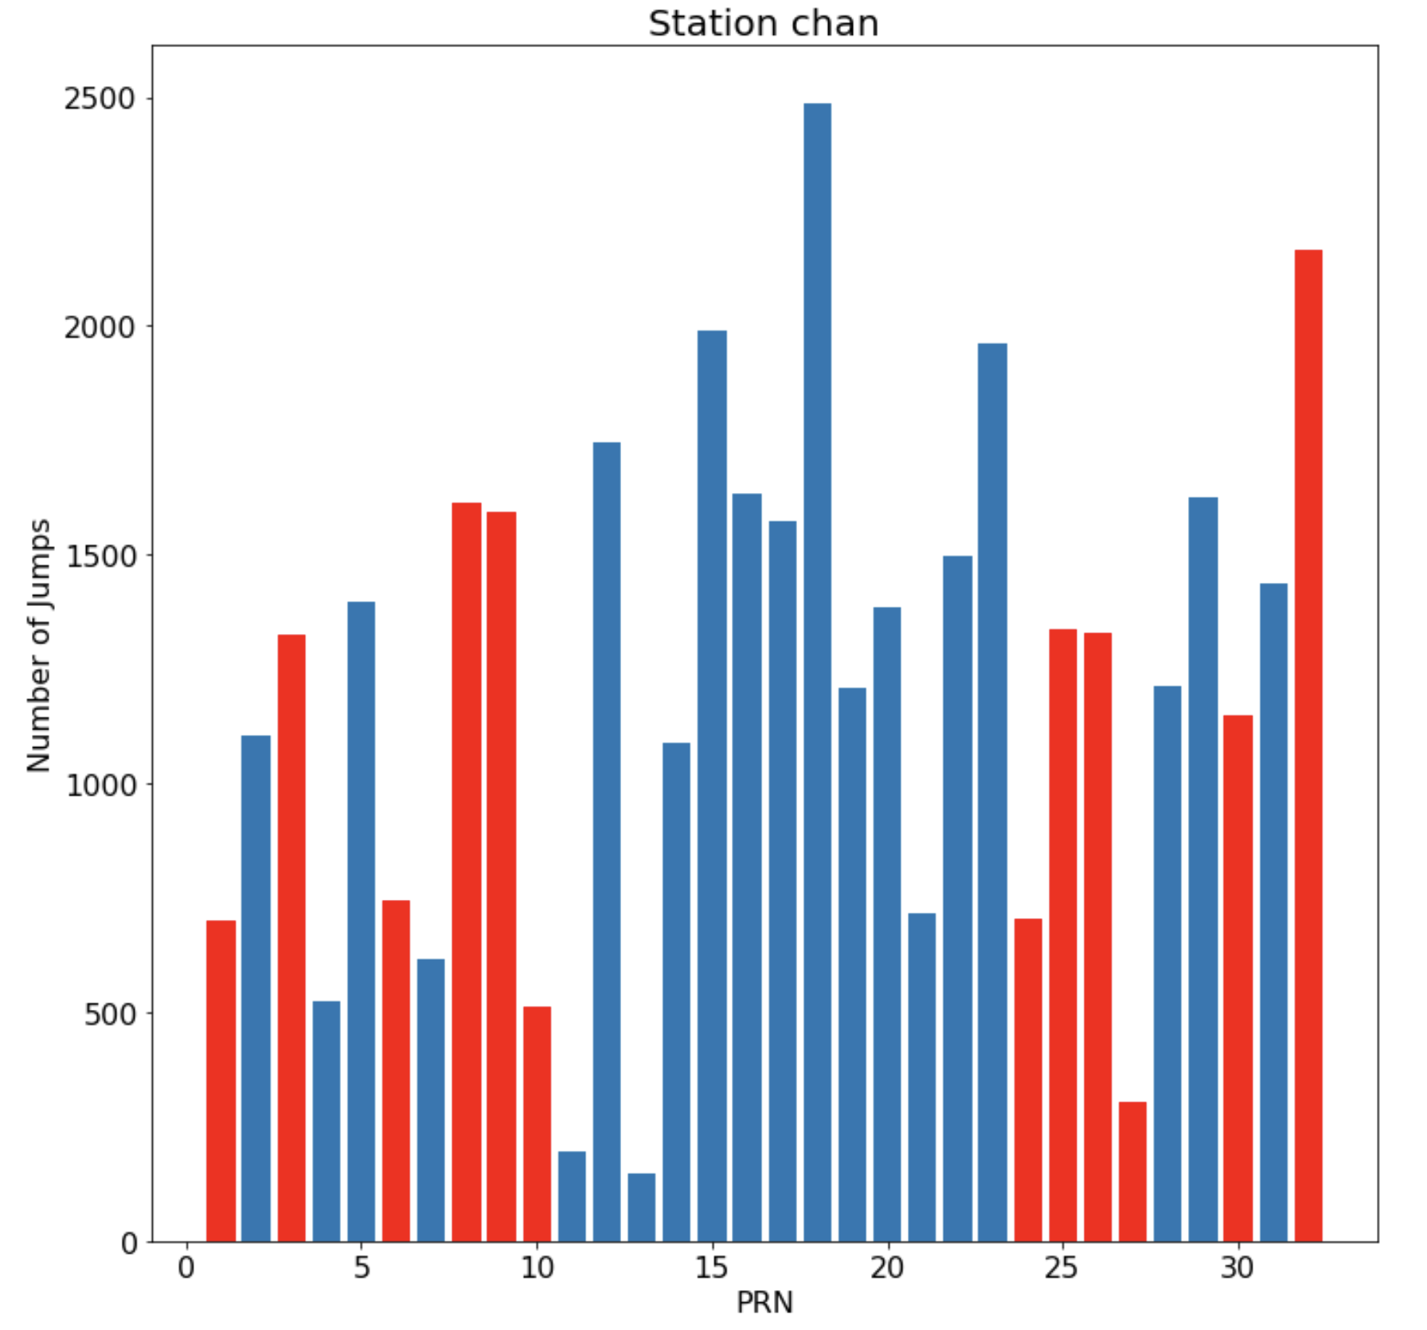
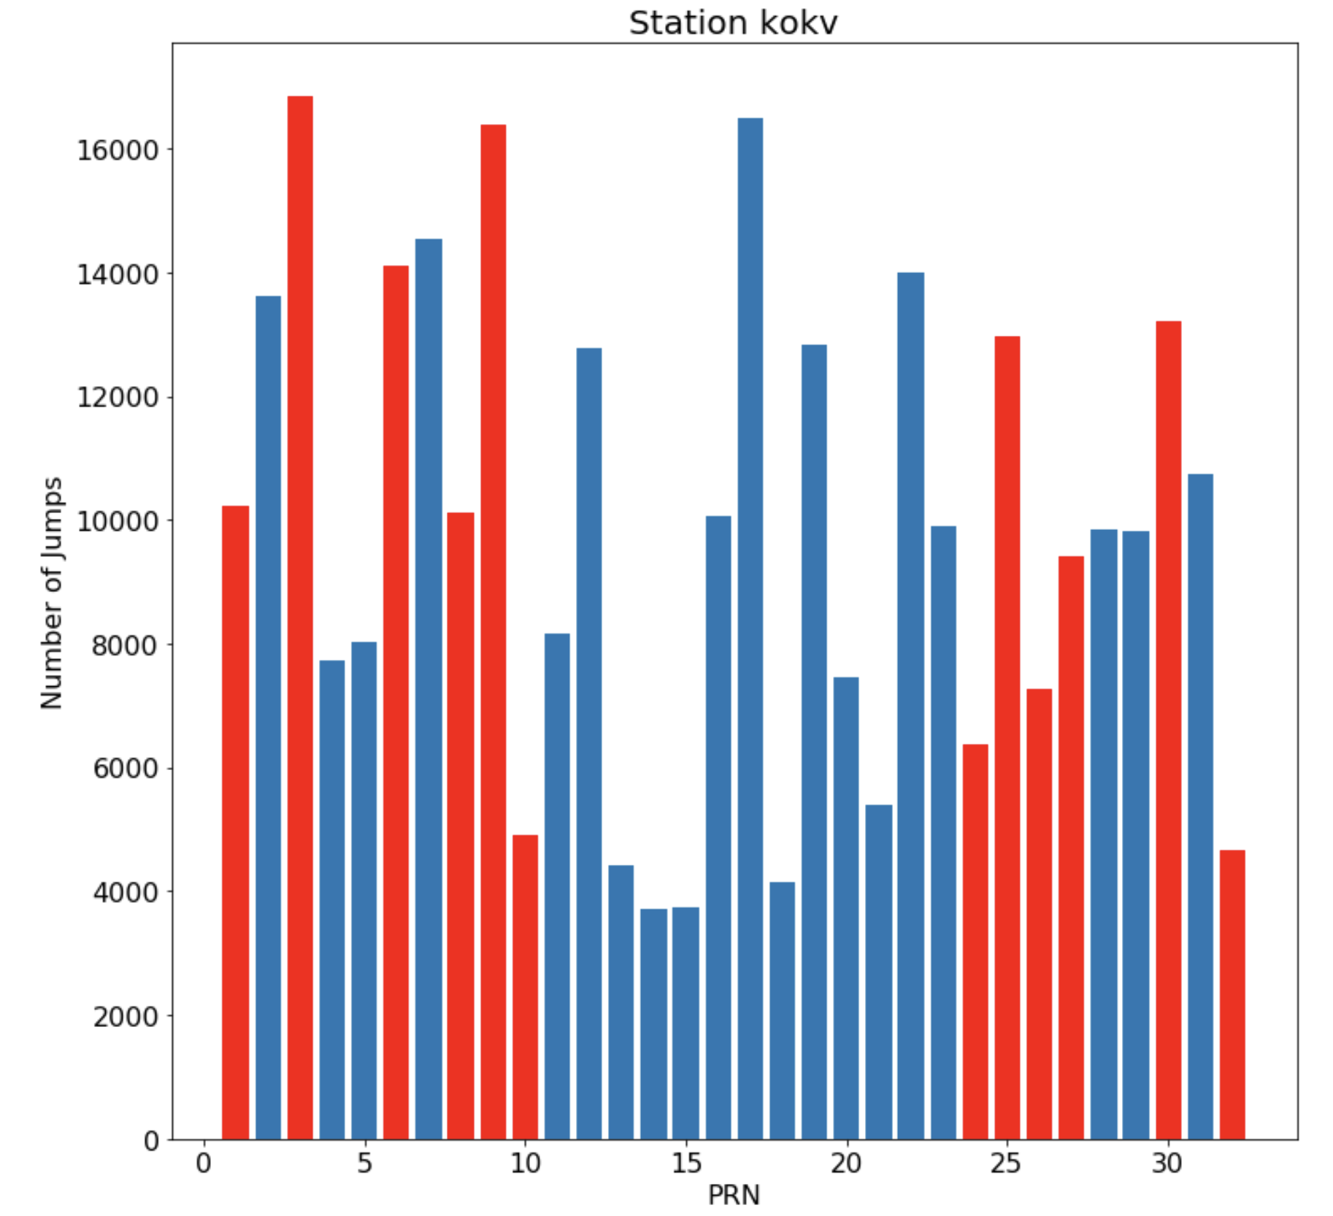
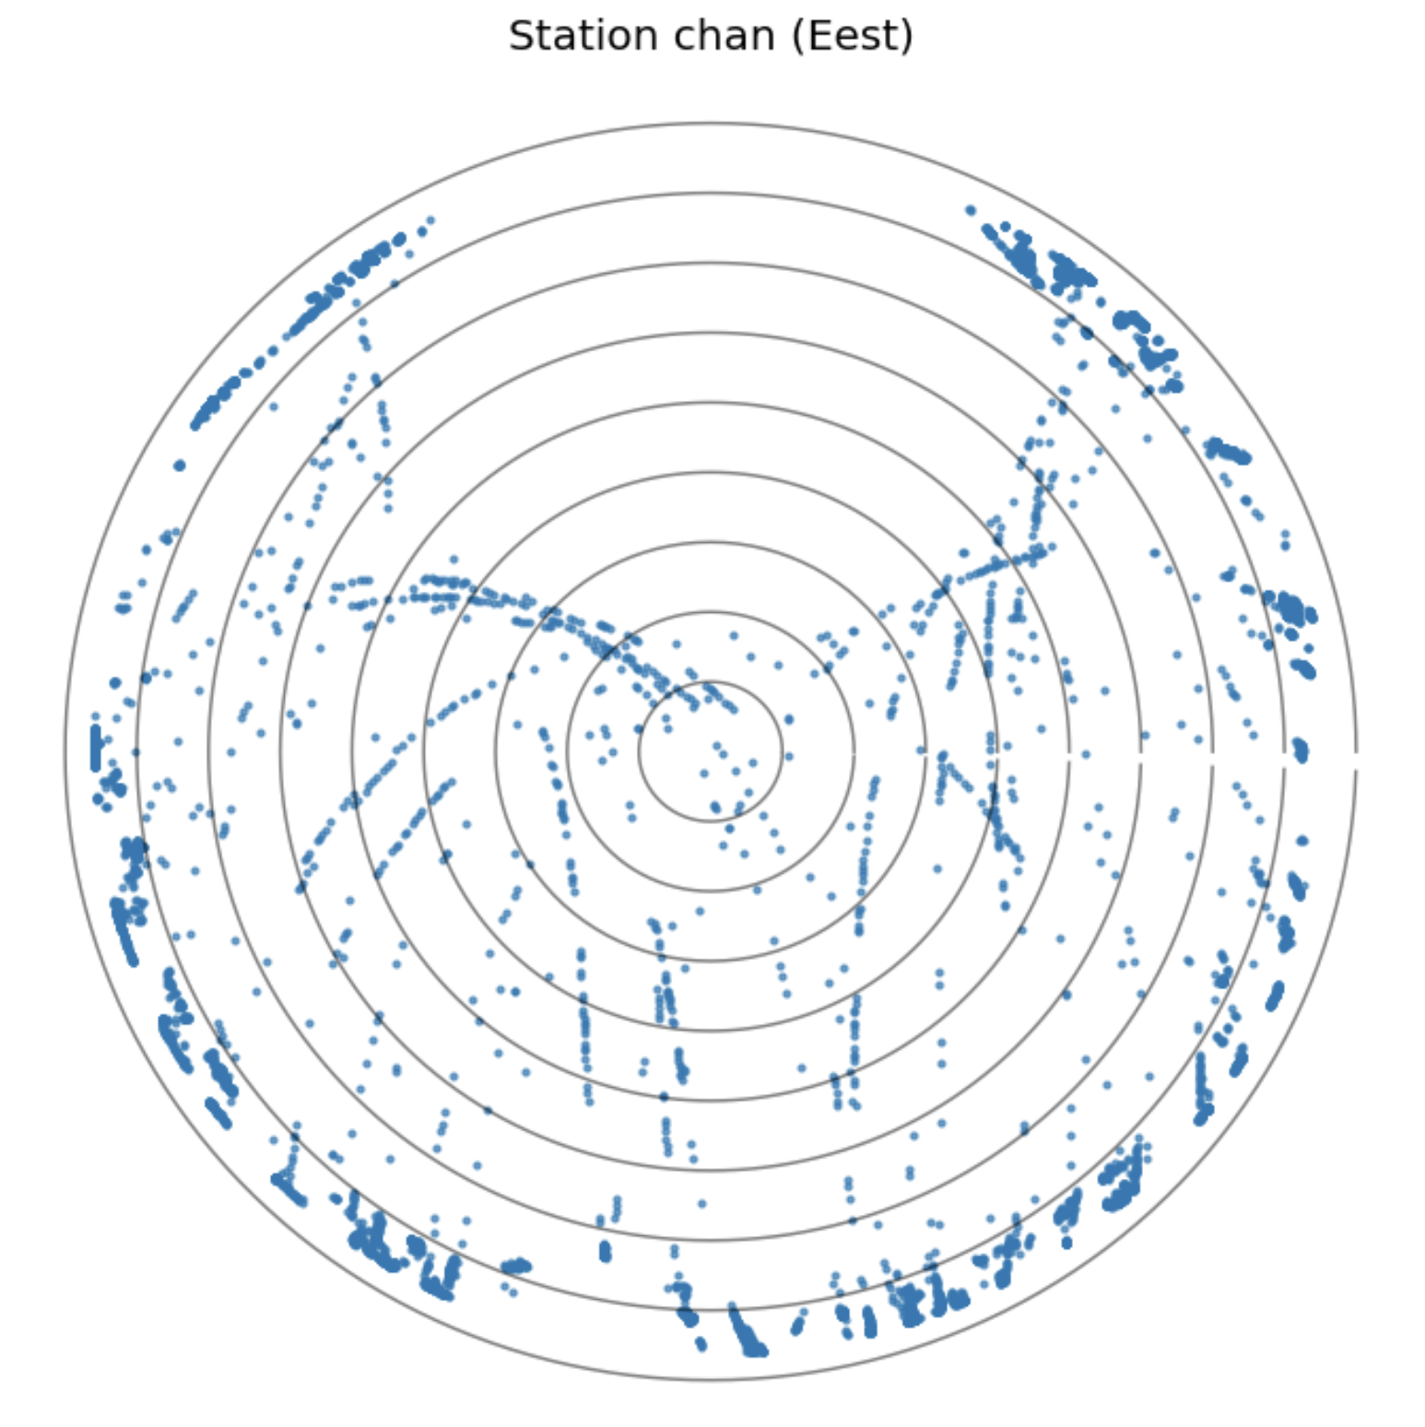
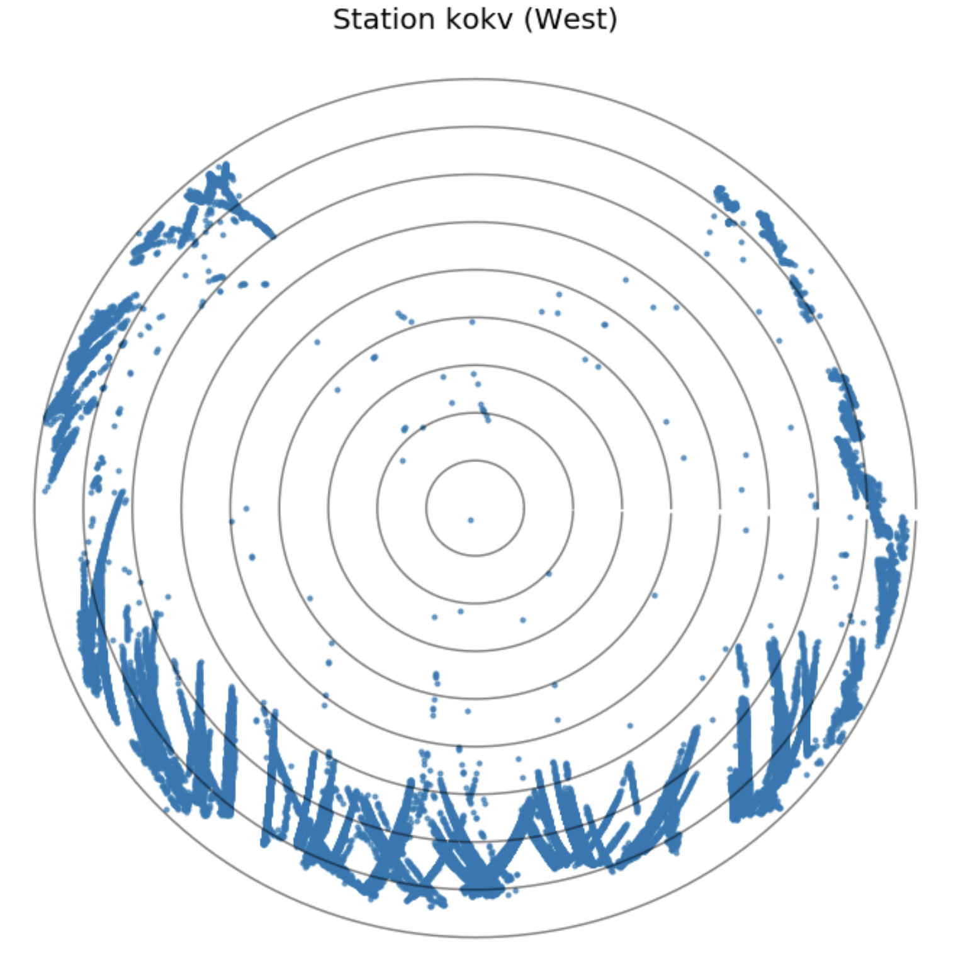
Conclusion

Slide 7
Conclusion
From the bar plot, there is no clearly evidence showing that the IIF blocks satellite has significant different than other satellite.
Notes:
bullets

